Slide 1

Domain Adaptation for Semantic Parsing
Zechang Li^{1,2}, Yuxuan Lai¹, Yansong Feng^{1,3*} and Dongyan Zhao^{1,2}
¹ Wangxuan Institute of Computer Technology, Peking University, Beijing, China
² Center for Data Science, Peking University, Beijing, China
³ The MOE Key Laboratory of Computational Linguistics, Peking University, China

Slide 2
Background
utterance: how long is the weekly standup meeting
logical form: listValue ( getProperty en.meeting.weekly_standup ( string length ) )

Slide 3
Background
target domain: calendar
few

Slide 4
Background
target domain: calendar
few
source domain: housing, restaurants, …, publications
sufficient

Slide 5
Motivation
Domain | Instance
calendar | utterance: meetings attended by two or more people logical form: listValue ( countComparative ( getProperty ( singleton en.meeting ) ( string !type ) ) ( string attendee ) ( string >= ) ( number 2 ) )
housing | utterance: housing units with 2 neighborhoods logical form: listValue ( countComparative ( getProperty ( singleton en.housing_unit ) ( string !type ) ) ( string neighborhood ) ( string = ) ( number 2 ) )

Slide 6
Motivation
Domain | Instance
calendar | utterance: meetings attended by two or more people logical form: listValue ( countComparative ( getProperty ( singleton en.meeting ) ( string !type ) ) ( string attendee ) ( string >= ) ( number 2 ) )
housing | utterance: housing units with 2 neighborhoods logical form: listValue ( countComparative ( getProperty ( singleton en.housing_unit ) ( string !type ) ) ( string neighborhood ) ( string = ) ( number 2 ) )
sketch

Slide 7
Motivation
utterance: how long is the weekly standup meeting
coarse stage
sketch: listValue ( getProperty@1 ( string@1 ) )
fine stage
logical form: listValue ( getProperty en.meeting.weekly_standup ( string length ) )
[Dong et al. 2018]

Slide 8
Domain-Aware seMantic Parser
sketch
logical form
coarse stage
fine stage
decoder1
decoder2
utterance
representations
sketch
representations
encoder1
encoder2
encoder3
utterance

Slide 9
Domain Discrimination
sketch
logical form
decoder1
decoder2
self-attention
self-attention
discriminator
confusing
distinguishable
encoder1
encoder2
encoder3
utterance

Slide 10
Domain Relevance Attention
sketch
logical form
domain
invariant
domain
specific
decoder1
domain relevance
decoder2
encoder1
encoder2
encoder3
utterance

Slide 11



Domain Relevance Attention
$$α_{t}=softmax(U⋅d_{t})$$
$$[d_{t};c_{t}]$$
$$c_{t}=U⋅α_{t}$$

Slide 12
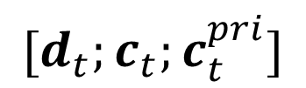
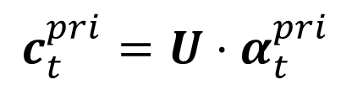
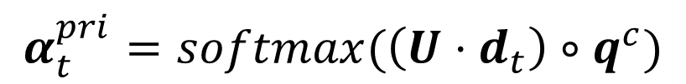
Domain Relevance Attention
$$α_{t}=softmax(U⋅d_{t})$$
$$[d_{t};c_{t}]$$
$$c_{t}=U⋅α_{t}$$
$$α_{t}^{pri}=softmax(\left(U⋅d_{t}\right)∘q^{c})$$
$$[d_{t};c_{t};c_{t}^{pri}]$$
$$c_{t}^{pri}=U⋅α_{t}^{pri}$$

Slide 13
Experiments
 | recipes | publications | calendar | housing | average
seq2seq | 58.80 | 36.64 | 34.52 | 36.50 | 41.62
coarse2fine | 62.96 | 38.51 | 38.10 | 39.15 | 44.68
p-share | 51.39 | 27.33 | 27.97 | 33.86 | 35.14
pre-train | 59.72 | 40.99 | 43.45 | 42.32 | 46.62
adversarial | 68.06 | 40.37 | 44.04 | 41.27 | 48.44
DAMP | 72.22 | 45.96 | 39.88 | 43.39 | 50.36

Slide 14
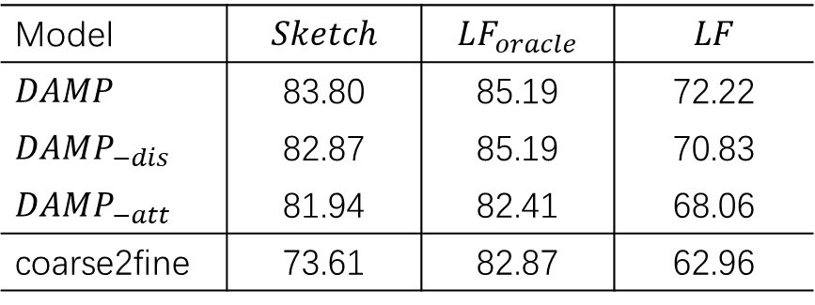
Experiments
Model | $$Sketch$$ | $$LF_{oracle}$$ | $$LF$$
$$DAMP$$ | 83.80 | 85.19 | 72.22
$$DAMP_{−dis}$$ | 82.87 | 85.19 | 70.83
$$DAMP_{−att}$$ | 81.94 | 82.41 | 68.06
coarse2fine | 73.61 | 82.87 | 62.96

Slide 15
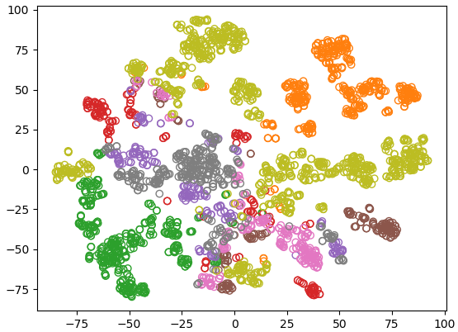
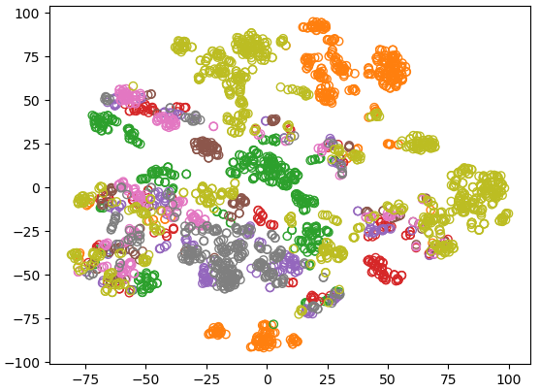
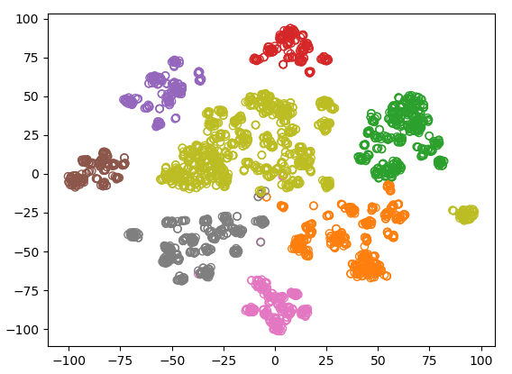

Experiments
CH = 332.47
(a) coarse2fine
CH = 88.89
CH = 1867.94
(b) DAMP - coarse
(c) DAMP - fine

Slide 16
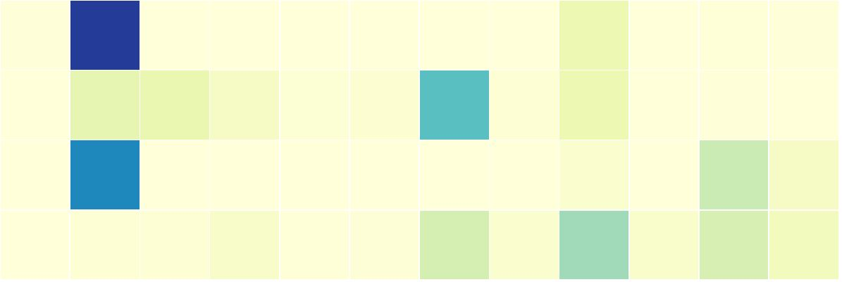

Experiments
(a) coarse2fine - fine
preparation_time
en.recipe
recipe.rice_pudding
cooking_time
en.recipe
(b) DAMP - fine
recipe.rice_pudding
cooking_time
cooking_time
which
recipes
take
at
most
as
long
to
cook
as
rice
pudding

Slide 17
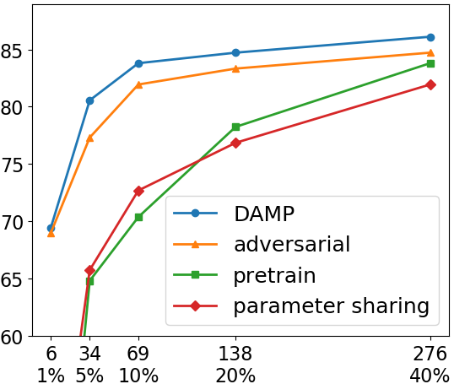
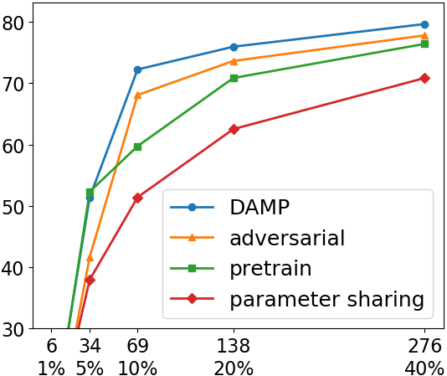
Experiments
sketch (EM)
logical (EM)
# of target domain instances
# of target domain instances

Slide 18

Thank you!
github

